Slide 1
WEEK 1b
COMPUTATIONAL MATHEMATICS

Slide 2
Outline
Introducing Scipy
Introducing Pandas

Slide 3
SCIPY
Python Libraries for Data Science

Slide 4

Python Libraries for Data Science
SciPy:
collection of algorithms for linear algebra, differential equations, numerical integration, optimization, statistics and more
part of SciPy Stack
built on NumPy
Link: https://www.scipy.org/scipylib/

Slide 5
Introducing SciPy
What is SciPy?
SciPy is an Open Source Python-based library, which is used in mathematics, scientific computing, Engineering, and technical computing.

Slide 6
Introducing SciPy
Why use SciPy
SciPy contains varieties of sub packages which help to solve the most common issue related to Scientific Computation.
SciPy is the most used Scientific library only second to GNU Scientific Library for C/C++ or Matlab's.
Easy to use and understand as well as fast computational power.
It can operate on an array of NumPy library.

Slide 7
Numpy VS SciPy
Numpy:
Numpy is written in C and use for mathematical or numeric calculation.
It is faster than other Python Libraries
Numpy is the most useful library for Data Science to perform basic calculations.
Numpy contains nothing but array data type which performs the most basic operation like sorting, shaping, indexing, etc.
SciPy:
SciPy is built in top of the NumPy
SciPy is a fully-featured version of Linear Algebra while Numpy contains only a few features.
Most new Data Science features are available in Scipy rather than Numpy.

Slide 8
Sub-packages of SciPy
File input/output - scipy.io
Special Function - scipy.special
Linear Algebra Operation - scipy.linalg
Interpolation - scipy.interpolate
Optimization and fit - scipy.optimize
Statistics and random numbers - scipy.stats
Numerical Integration - scipy.integrate
Fast Fourier transforms - scipy.fftpack
Signal Processing - scipy.signal
Image manipulation – scipy.ndimage

Slide 9
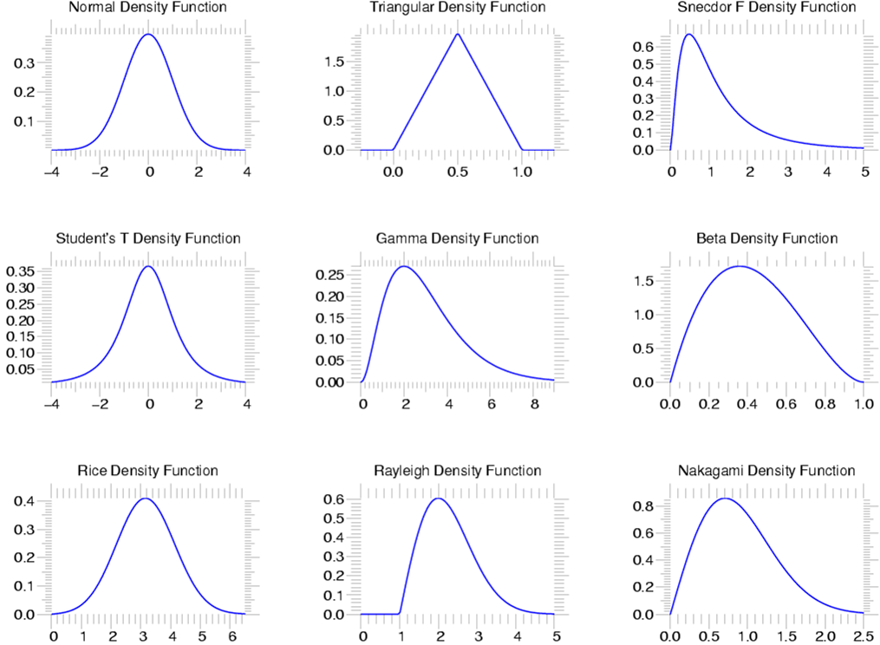
SciPy Statistics
scipy.stats --- CONTINUOUS DISTRIBUTIONS
over 80 continuous distributions!

Slide 10
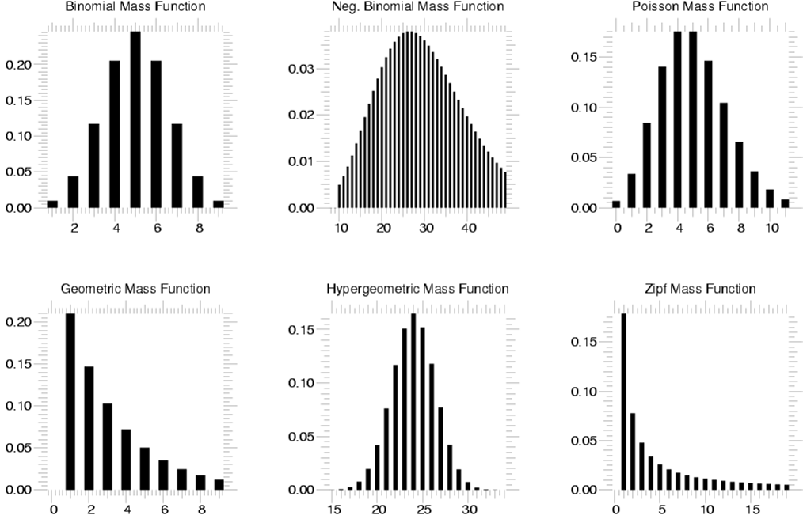
Statistics
scipy.stats --- Discrete Distributions
10 standard discrete distributions (plus any arbitrary finite random variates)

Slide 11
Descriptive Statistics
Some essential functions provide by scipy.stats package are described in the following table
Function | Description
describe() | Computes various descriptive statistics of the input array.
gmean() | Computes geometric mean along with the specified.
hmean() | Calculates the harmonic mean along the specified axis.
kurtosis() | Computes the Kurtosis.
mode() | Returns the mode value.
skew() | Tests the skewness of the data
zscore() | It calculates the z score of each value in the sample, relative to the sample mean and standard deviation.

Slide 12
Descriptive Statistics
This is how to use it..
import scipy as sp
import numpy as np
data1=sp.randn(100) #generate 100 random number
print(sp.median(data1))
print(sp.stats.describe(data1))
print(sp.stats.skew(data1))

Slide 13
Create a normal distributed random variable
We specify the distribution mean=1.0 and standard deviation=0.5
> X = sp.stats.norm(1, 0.5)
X is an object that represents a random variable
To draw a random sample from the distribution, we use rvs (random variable sample)
> X.rvs(10)
the resulting random numbers indeed are distributed according to the corresponding probability distribution function (you can check its mean and standard deviation)

Slide 14
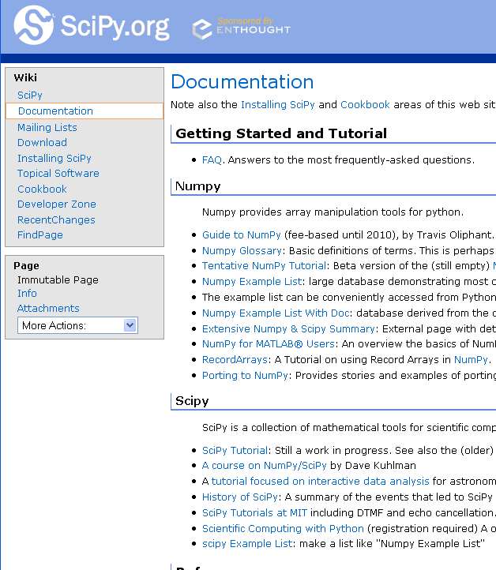
SCIPY DOCUMENTATION PAGE
http://www.scipy.org/Documentation

Slide 15
PANDAS
Python Libraries for Data Science

Slide 16

Python Libraries for Data Science
Pandas:
adds data structures and tools designed to work with table-like data (similar to Series and Data Frames in R)
provides tools for data manipulation: reshaping, merging, sorting, slicing, aggregation etc.
allows handling missing data
Link: http://pandas.pydata.org/

Slide 17
Introducing Pandas
References:
Jake VanderPlas, Jake. (2017). Chapter 3: Data Manipulation with Pandas. Python Data Science Handbook: Essential Tools for Working with Data. O’Reilly Media, Inc.
Johansson, R. (2015). Chapter 12: Data Processing and Analysis. Numerical Python: A Practical Techniques Approach for Industry. Apress.

Slide 18
Import Pandas
>import pandas as pd

Slide 19
Fundamental Pandas Data Structures
A Series is a one-dimensional array of indexed data
A DataFrame is an analog of a two-dimensional array with both flexible row indices and flexible column names.
An Index object can be thought of either as an immutable array or as an ordered set (technically a multiset, as Index objects may contain repeated values).

Slide 20
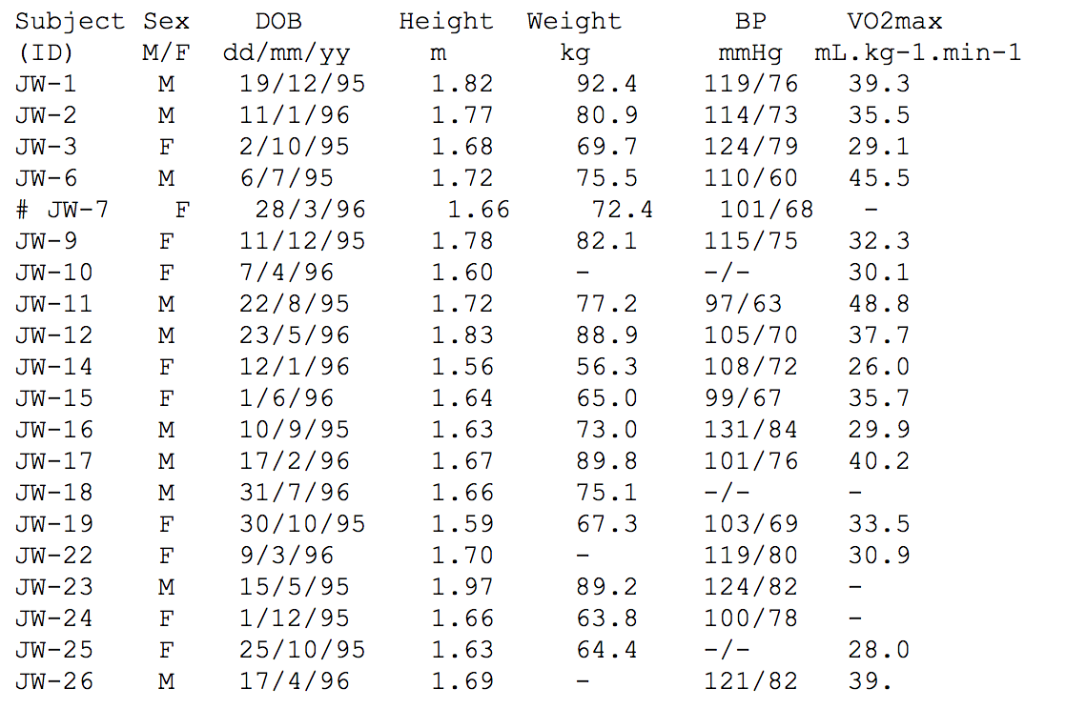
Pandas Dataframe
is two-dimensional size-mutable, potentially heterogeneous tabular data structure with labeled axes (rows and columns).
It consists of three principal components, the data, rows, and columns.

Slide 21
Data Frames methods
Unlike attributes, python methods have parenthesis.
All attributes and methods can be listed with a dir() function: dir(df)
df.method() | description
head( [n] ), tail( [n] ) | first/last n rows
describe() | generate descriptive statistics (for numeric columns only)
max(), min() | return max/min values for all numeric columns
mean(), median() | return mean/median values for all numeric columns
std() | standard deviation
sample([n]) | returns a random sample of the data frame
dropna() | drop all the records with missing values

Slide 22
Creating Pandas DataFrame
the easiest way is to pass:
a nested Python list or
dictionary to the constructor of the DataFrame object.
By using Python List
>df = pd.DataFrame([[909976, "Sweden"],
[8615246, "United Kingdom"],
[2872086, "Italy"],
[2273305, "France"]])

Slide 23
Labeled Indexing
We can assign a sequence of labels to the index attribute (rows) and the columns attribute
>df.index = ["Stockholm", "London", "Rome", "Paris"]
>df.columns = ["Population", "State"]

Slide 24
Creating DataFrame
By using Dictionary
An alternative way we can pass a dictionary with column titles as keys and column data as values
>df = pd.DataFrame({"Population": [909976, 8615246, 2872086, 2273305], "State": ["Sweden", "United Kingdom", "Italy", "France"]}, index=["Stockholm", "London", "Rome", "Paris"])

Slide 25
Selecting a column in a Data Frame
Method 1: Subset the data frame using column name:
df['Population']
Method 2: Use the column name as an attribute:
df.Population

Slide 26
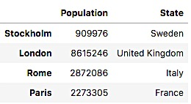
Access specific index: method loc
Single label
> df.loc['Stockholm']
List of labels
> df.loc[['Stockholm','London']]
Single label for row and column
> df.loc['Stockholm','Population']
df.loc gets rows (or columns) with particular labels from the index.
df.iloc gets rows (or columns) at particular positions in the index (so it only takes integers).
Notes:
https://www.w3resource.com/pandas/dataframe/dataframe-loc.php

Slide 27
Access specific index: method loc
Slice with labels for row and single label for column.
> df.loc['Stockholm':'Rome','Population']
note: here both the start and stop of the slice are included.
'Stockholm':'Rome'

Slide 28
Access specific index: method iloc
If we need to select a range of rows and/or columns, using their positions we can use method iloc[]:
#Select rows by their labels:
df.iloc[0:2,[0, 1]]

Slide 29
Access specific index: method iloc (summary)
df.iloc[0] # First row of a data frame
df.iloc[i] #(i+1)th row
df.iloc[-1] # Last row
df.iloc[:, 0] # First column
df.iloc[:, -1] # Last column
df.iloc[0:7] #First 7 rows
df.iloc[:, 0:2] #First 2 columns
df.iloc[1:3, 0:2] #Second through third rows and first 2 columns
df.iloc[[0,5], [1,3]] #1st and 6th rows and 2nd and 4th columns

Slide 30
Filtering
To subset the data we can apply Boolean indexing. This indexing is commonly known as a filter
> df.loc[df.Population > 1000000]
Any Boolean operator can be used to subset the data:
> greater; >= greater or equal;
< less; <= less or equal;
== equal; != not equal;
df.Population > 1000000

Slide 31
Change the value
Using the same method to call specific data, you can also update/assign the new value
> df.loc['Stockholm','Population']=111
We can also use loc to add the new data
> df.loc['Alabama']=[13123123,'US']

Slide 32
Data Frames: Sorting
We can sort the data by a value in the column. By default the sorting will occur in ascending order and a new data frame is return.
df.sort_values(by ='Population')

Slide 33
Data Frames: Sorting
We can sort the data using 2 or more columns:
df.sort_values( by =['State','Population'])

Slide 34
Dealing with Missing Values
Missing values are marked as NaN
# Select the all the columns that have at least one missing value
df.isnull().any()
# Select the rows that have at least one missing value
df[df.isnull().any(axis=1)]

Slide 35
Missing Values
There are a number of methods to deal with missing values in the data frame:
df.method() | description
dropna() | Drop missing observations
dropna(how='all') | Drop observations where all cells is NA
dropna(axis=1, how='all') | Drop column if all the values are missing
dropna(thresh = 5) | Drop rows that contain less than 5 non-missing values
fillna(0) | Replace missing values with zeros
isnull() | returns True if the value is missing
notnull() | Returns True for non-missing values

Slide 36
Missing Values
When summing the data, missing values will be treated as zero
If all values are missing, the sum will be equal to NaN
cumsum() and cumprod() methods ignore missing values but preserve them in the resulting arrays
Missing values in GroupBy method are excluded
Many descriptive statistics methods have skipna option to control if missing data should be excluded. This value is set to True by default

Slide 37
Computing Descriptive Statistics
We can compute descriptive statistics (mean, std, median, min, max, etc.) for a DataFrame
> df.Population.max()

Slide 38
Data Frames groupby method
Allows us to group rows by the values of a given column and apply a function on the resulting object (e.g. sum, mean, min, max, count, etc.)
> df.groupby("State").count()
If you just want to show particular column, just call by the specific column label
> df.groupby("State").count()[‘Population’]
Note: If single brackets are used to specify the column (e.g. Population), then the output is Pandas Series object. When double brackets are used the output is a Data Frame

Slide 39
Data Frames groupby method
Once groupby object is create we can calculate various statistics for each group:
#add new observation
df.loc['Newcastle']=[13123123,'United Kingdom']
#calculate the sum of population on each state
df.groupby('State')[['Population']].sum()
Note: If single brackets are used to specify the column (e.g. salary), then the output is Pandas Series object. When double brackets are used the output is a Data Frame

Slide 40
count | Number of non-null observations
sum | Sum of values
mean | Mean of values
mad | Mean absolute deviation
median | Arithmetic median of values
min | Minimum
max | Maximum
mode | Mode
abs | Absolute Value
prod | Product of values
std | Unbiased standard deviation
var | Unbiased variance
sem | Unbiased standard error of the mean
skew | Unbiased skewness (3rd moment)
kurt | Unbiased kurtosis (4th moment)
quantile | Sample quantile (value at %)
cumsum | Cumulative sum
cumprod | Cumulative product
cummax | Cumulative maximum
cummin | Cumulative minimum
The full range of basic statistics that are quickly calculable and built into the base Pandas package are:
https://pandas.pydata.org/pandas-docs/stable/getting_started/basics.html#descriptive-statistics

Slide 41
Hands-on exercises
Read csv data from: salaries.csv
Give the summary for the numeric columns in the dataset
Calculate standard deviation for all numeric columns;
What are the mean values of the first 50 records in the dataset?

Slide 42
Please familiarized yourself with the following:
Importing CSV data
Handling Missing Data (p.119)
Replace cell data
Aggregation and Grouping
Sorting

Slide 43
Exercise for Pandas
From the data set: automobile.csv print first and last five rows
Find the null value in the data and fill with zeros
Find the most expensive car company name
Print all Toyota cars details
Count total cars per company
Find each company’s highest price car
Find the average mileage of each car making company
Create a new variable which contains the last 20 rows of the original table

Slide 44
Link to dataset
http://bit.ly/dataset_compmath

